Slide 1
Work Progress
By: Abdur Rehman

Slide 2
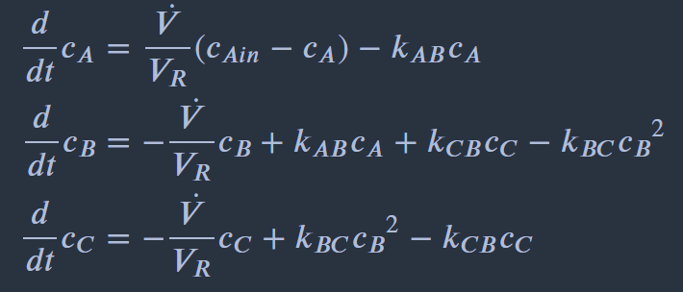
Plant Model: Continuously Stirred Tank Reactor (CSTR)
The component balances are:
where;
The total volume entering is equal to the volume leaving the system: 𝑉˙𝑖𝑛=𝑉˙𝑜𝑢𝑡=𝑉˙=𝑐𝑜𝑛𝑠𝑡.
The input of the system is the concentration of component 𝐴 at the reactor inlet (𝑐𝐴𝑖𝑛) , the measured outputs are the concentrations of component 𝐵 (𝑐𝐵) and 𝐶 (𝑐𝐶).

Slide 3
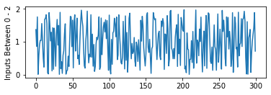
Implementation of Random Input Signals:
random signal generation of the input
a_range = [0, 2]
input_values.append(cAin)
Observing the change in States
Extract the plant states from the integerator results and add the intial condition to the extracted states-
plant_state = vertcat(x0.T, result['xf'].T)
Saving & appending the Input and State Values from the simulated function
state_values.append(plant_state[1, :])
Initial Condition of Plant
x0 = DM([0.2, 0.3, 0.1])

Slide 4
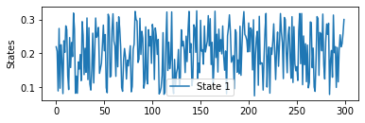
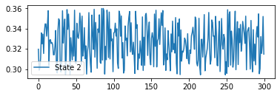
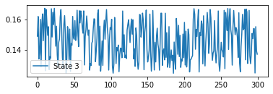
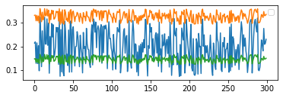
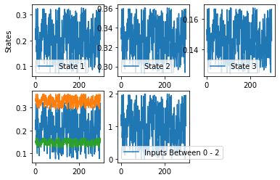
State Result:

Slide 5
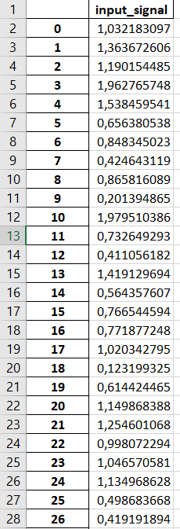
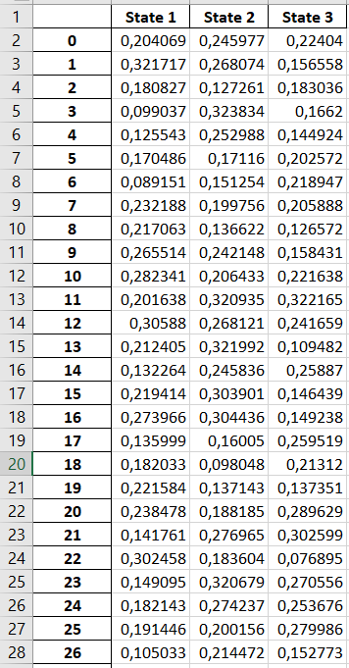
Data Stored in Excel

